Slide 1
Problem statement
Exercise 1
Using the semantic tableaux method decide what kind (consistent, inconsistent, valid) of formula is U _{j}, j ϵ {1,2,…,8}
If U _{j}, j ϵ {1,2,…,8} is consistent, find all its models.

Slide 2
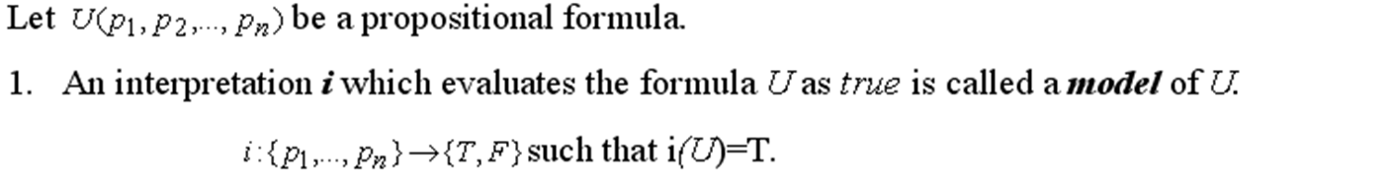

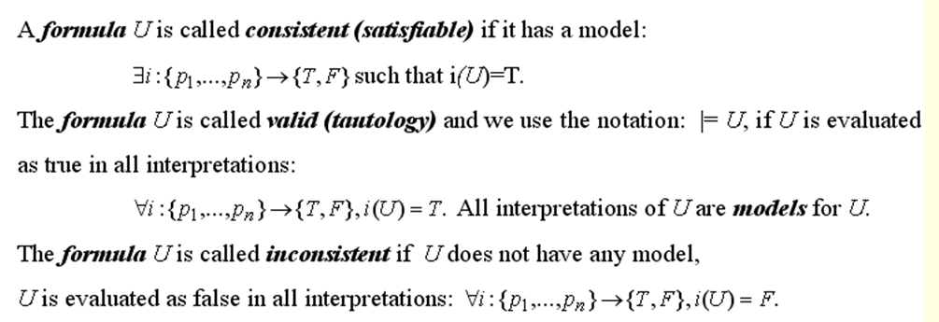
Theory

Slide 3
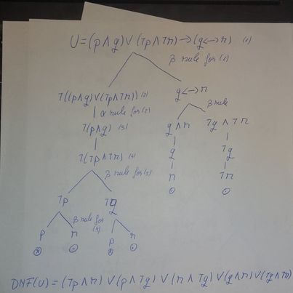

Slide 4
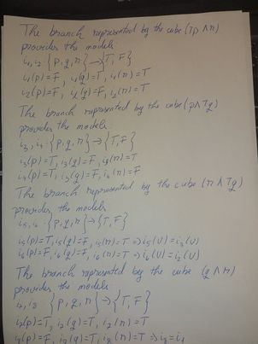

Slide 5
The branch represented by the cube (¬q ∧ ¬r) provides the models:
i₉ ,i₁₀:{p,q,r} {T,F}
i₉(p) = T, i₉(q) = F, i₉(r) = F => i₉(U)=i4(U)
i₁₀(p) = F, i₁₀(q) = F, i₁₀(r) = F
U has 6 models.
Having at least one model, U is a consistent formula, but it is not valid because it does not have 8 models.

